Slide 1
Converting Relational Databases into XML Documents
Robert Hoover

Slide 2
Introduction
Original paper authored by Joseph Fong, Francis Pang, and Chris Bloor
Suggested that currently the only method for creating document type definitions is through the use of markup declarations.
This is prior to the creation of the standard XSD format we have today.
Uses reverse engineering to transform a database into a EER model then forward engineering to create the XML schema and document.

Slide 3
Introduction to my project
Created through PHP and data stored in a MySQL database.
Goal was to follow the 7 steps listed in original research paper.
Discovered that some steps required a knowledge discovery algorithm to be implemented.
Step 1: Entity to Element was the easiest component to implement.
Step 2: Relationship to HREF was completed, however using the up to date standards specified by XSD.
Steps 3 – 5 that deal with super types and specializations were not able to be implemented successfully.
Steps 6 & 7 which deal with participation and cardinality were partially implemented.

Slide 4
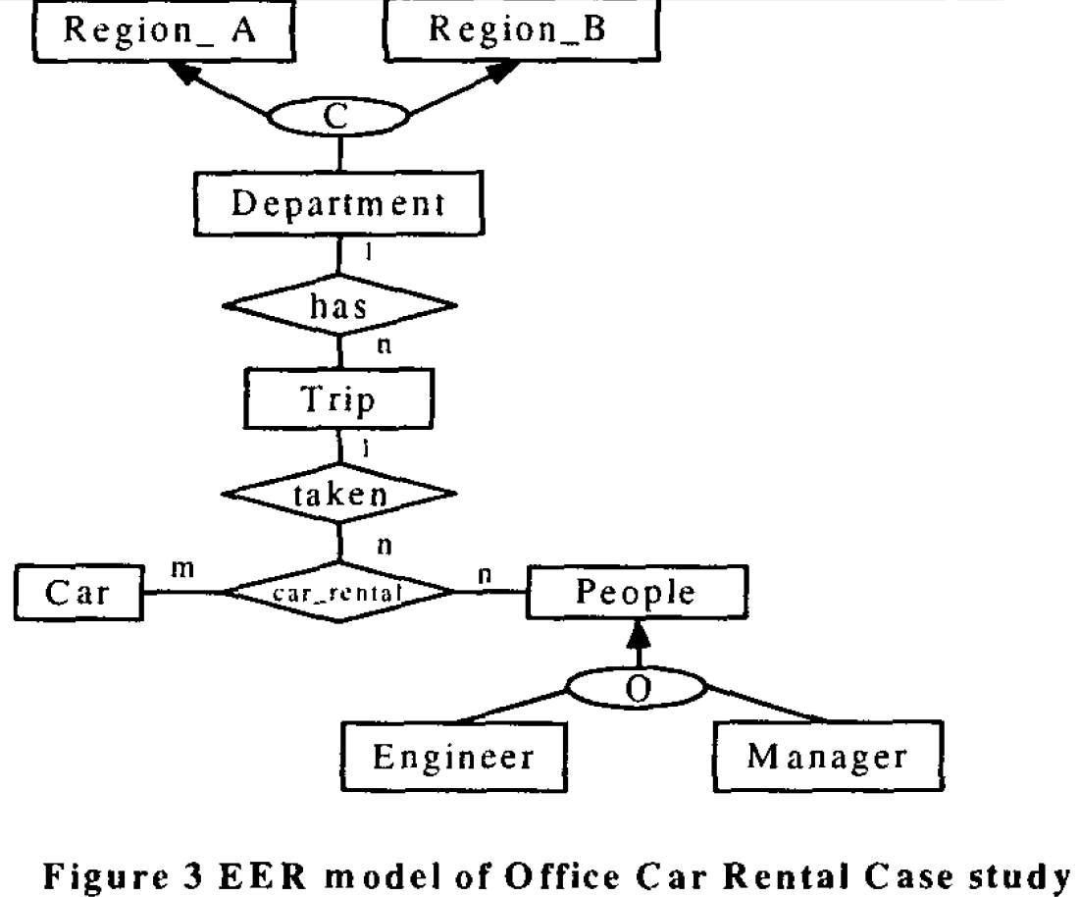
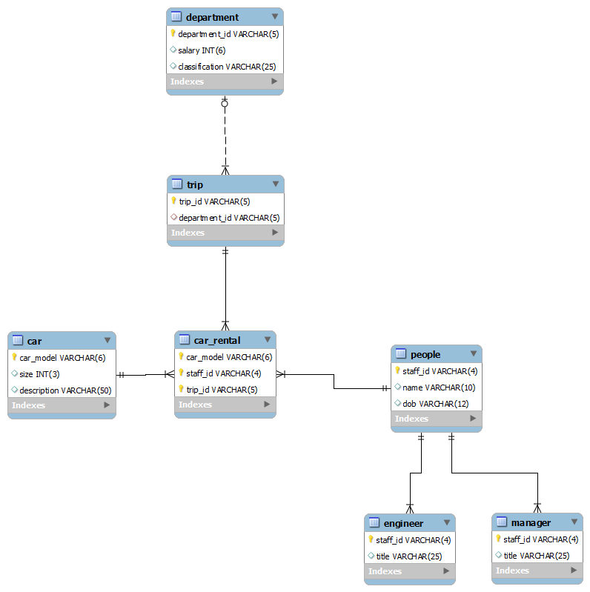
Database Schema

Slide 5
Benefits of conversion to XML
Easy to read small sets of data as text.
Simple queries can be handled efficiently using Xpath
Web browsers natively support parsing of XML data files.

Slide 6
Why not convert?
Slow conversion time for large databases.
Complex queries that are easy to write in SQL may not even be possible using Xpath due to the tree like structure of an XML file.
You may end up going through the entire XML file multiple times causing slow query times.

Slide 7
Query Time
Used simple query of get the names of all employees
SELECT name from people;
people/name
For sample set of data the query time was 0.001 seconds for XML and 0.002 for SQL.
For larger set of data, 1000 extra staff, query time was 0.005 seconds for Xpath and 0.003 seconds for SQL.
For maximum set size of 10000 extra staff, query time was 0.049 seconds for XML and 0.017 seconds for SQL.
Shows that Xpath times do increase more rapidly.

Slide 8
Creation of Schema Time
With only original data set it took 0.006 seconds to generate the schema.
This will not change with more entries, only with more tables and keys.

Slide 9
Creation of XML file
With original number of entries this took 0.016 seconds.
With an additional 10000 entries in the people table this took 0.312 seconds. This is a substantial increase in time.

